Slide 1
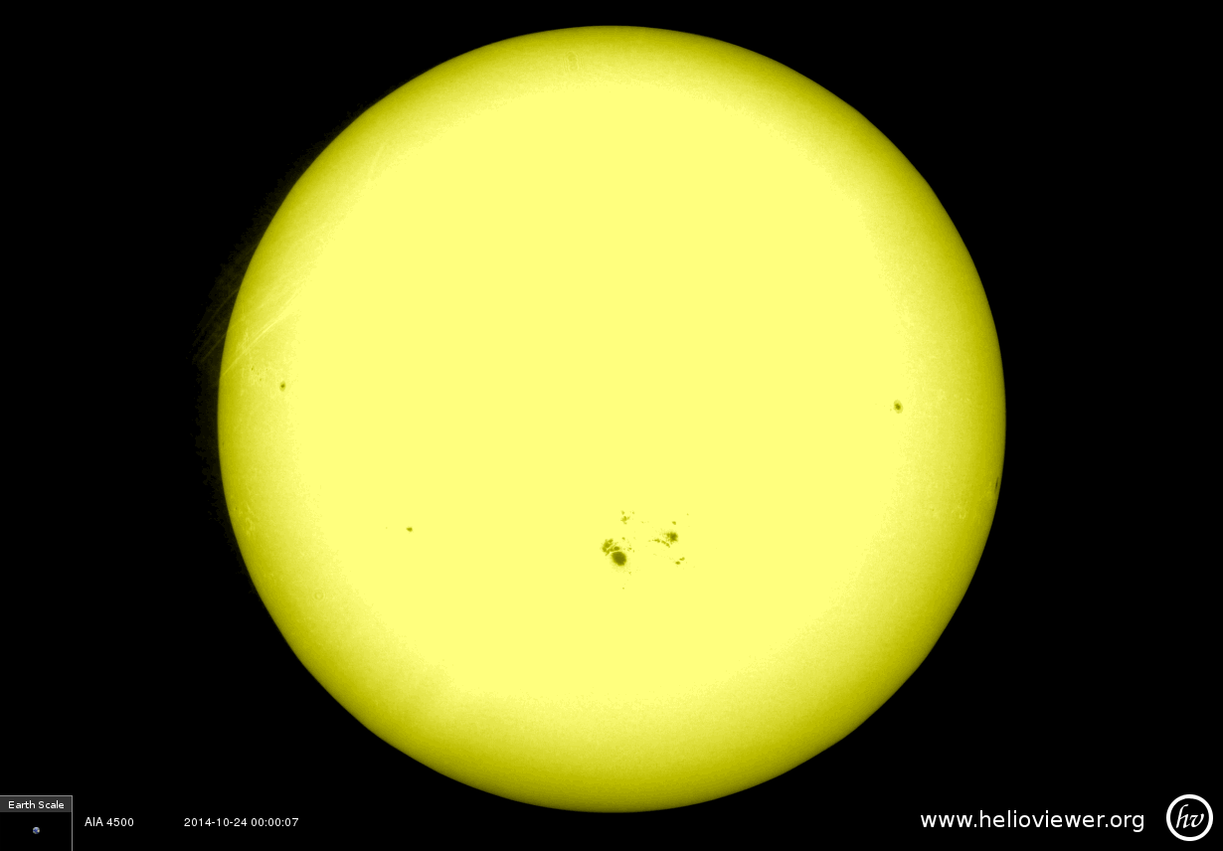
Photosphere
Visible

Slide 2
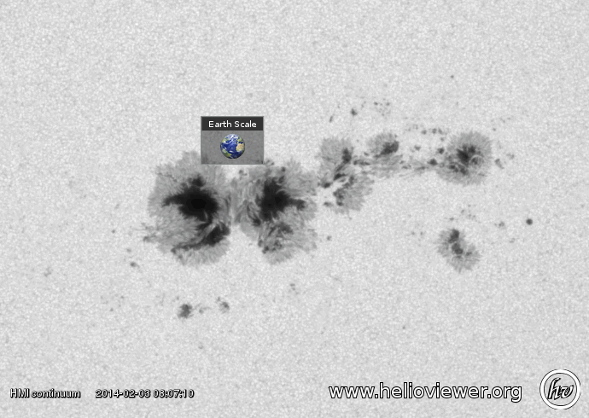
Sun Spot
Extreme Ultraviolet

Slide 3
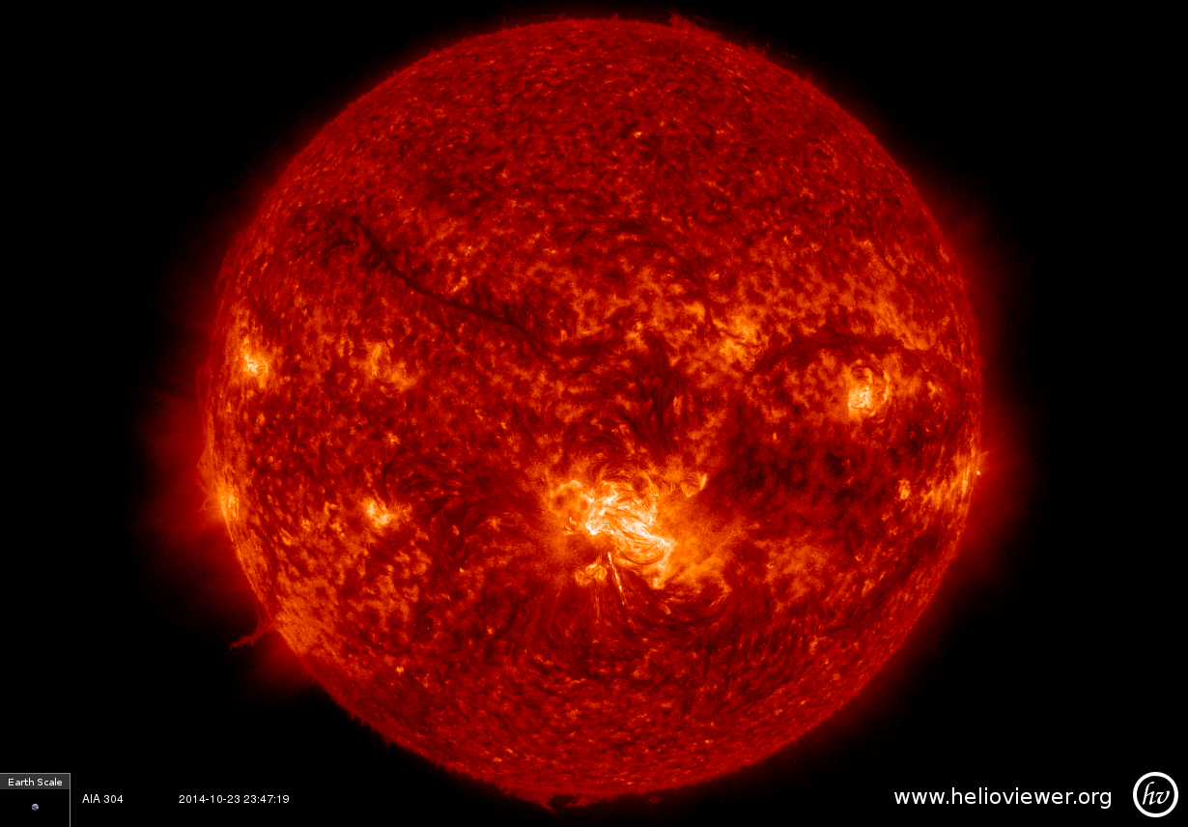
Chromosphere
Extreme Ultraviolet

Slide 4
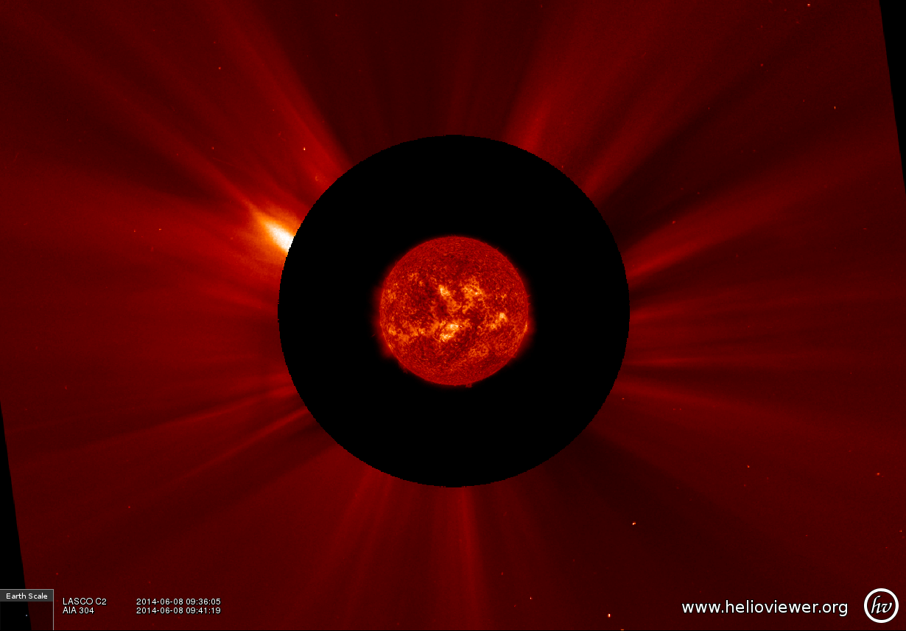
Corona
No data in this region
Extreme Ultraviolet and Visible

Slide 5
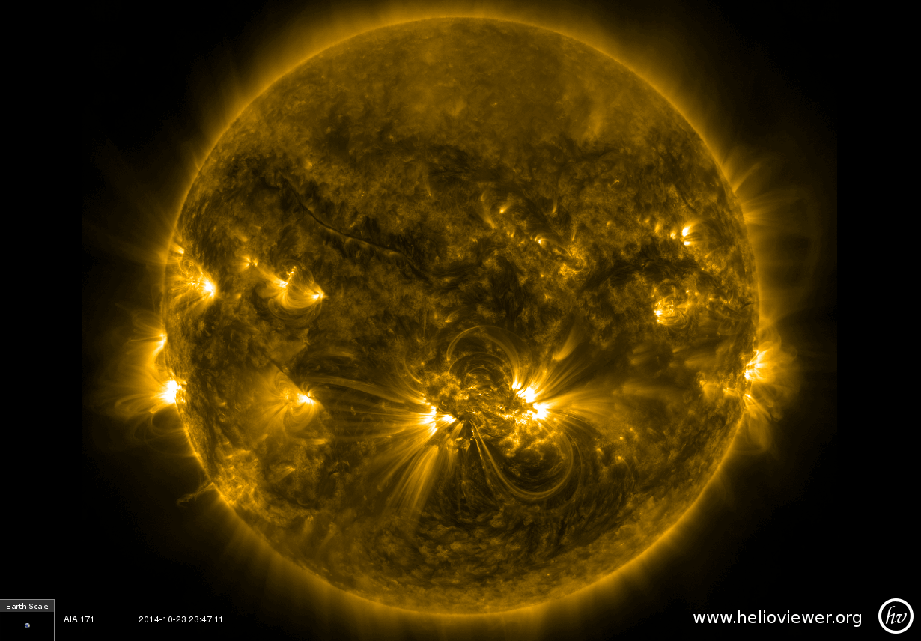
Coronal Loop
Extreme Ultraviolet

Slide 6
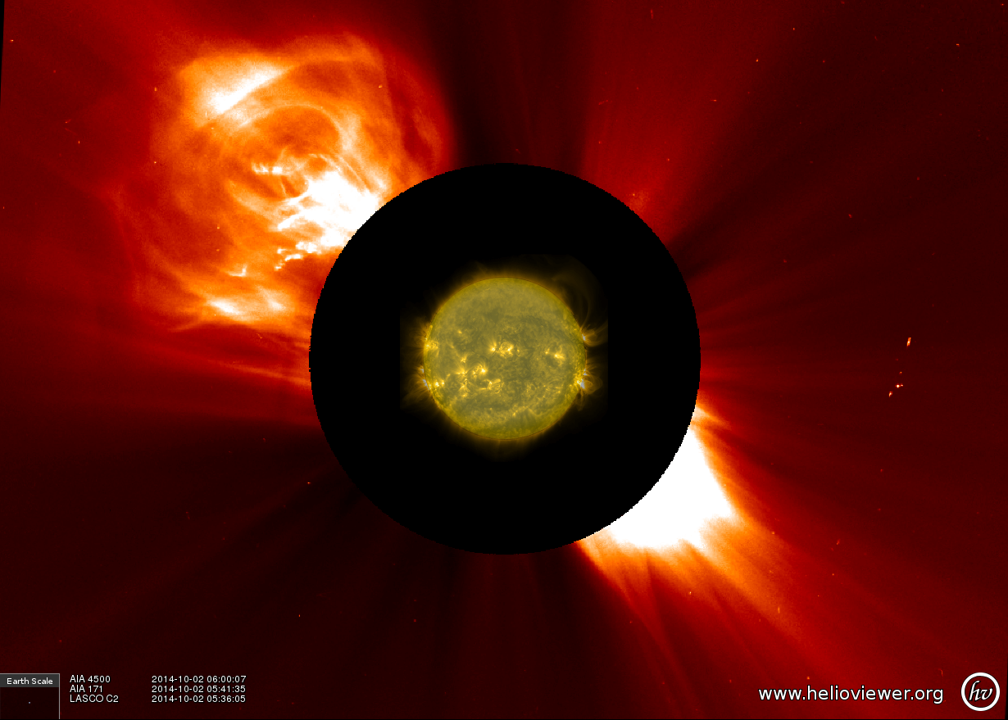
Coronal Mass Ejection
No data in this region
Visible

Slide 7
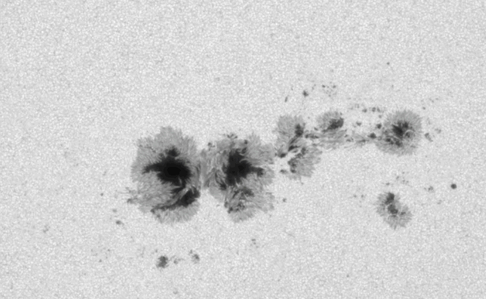
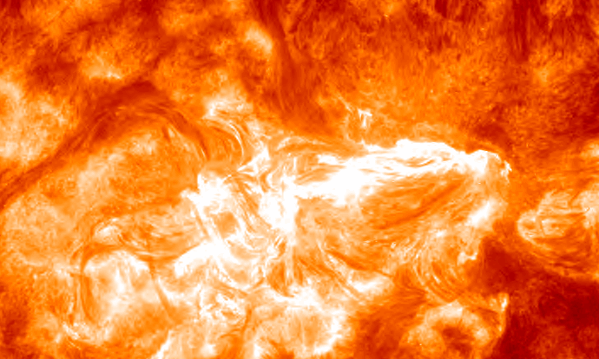
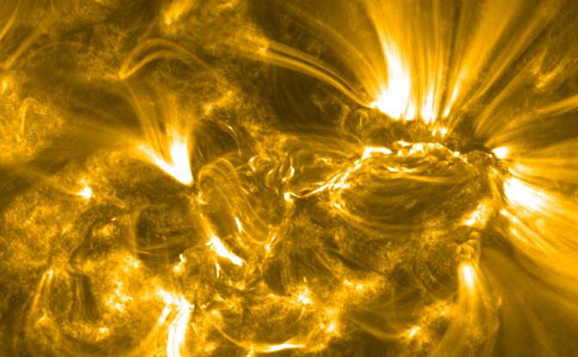
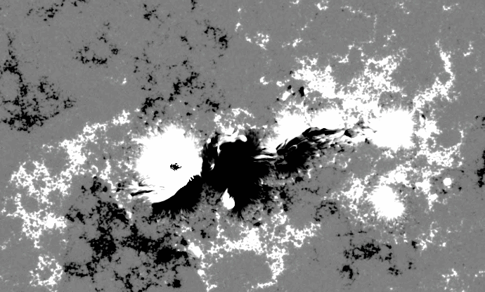
Photosphere (Visible)
Chromosphere (Ultraviolet)
All frames showing the same snapshot of the Sun in different light
Corona (Extreme Ultraviolet)
Sun Spot (Magnetic Field)

Slide 8
Instructor Notes
These images correspond to the layers of the Sun discussed in the Features of the Sun – 3D Sun lesson.
Layers
  Photosphere: The region of the Sun that we can see in visible light with our eyes.
  Chromosphere: The chromosphere is the layer just above the photosphere. It is where we begin to see the bright gases of active regions.
  Corona: The outermost layer of the Sun’s atmosphere is called the corona. This stretches from close to the Sun’s surface, out towards the planets
Features
  Coronal loops are made of up of very hot gas that is attracted to magnetic field loops. These are where solar flares and coronal mass ejections originate.
  Coronal mass ejections are eruptions of huge amounts of gas and magnetic field from the Sun that travel through space and can encounter planets on their way.
  Sunspots are seen as black spots on the photosphere where the magnetic field of the Sun is protruding through the surface, pushing the hot gas out of the way. See how big they are by comparing the zoomed in sunspot to the Earth.
Notice that we need images of the Sun in many different wavelengths to be able to see what is happening.
The frame with four images shows a zoomed in section of the large bright region in the “Coronal Loop” image, taken in four different types of light. Notice how different each picture looks, despite them all being of the same thing.
Since we cannot see most of the electromagnetic (EM) spectrum with our eyes, scientists apply false color to images of different wavelengths in order to make features stand out clearer, and to tell the different wavelengths apart. The Sun is not actually colored as it appears here – this is just using light as a tool.
These images were gathered using the www.helioviewer.org website (you can create your own images there too!) using data from the Solar Dynamics Observatory and the Solar and Heliospheric Observatory.

